Slide 1
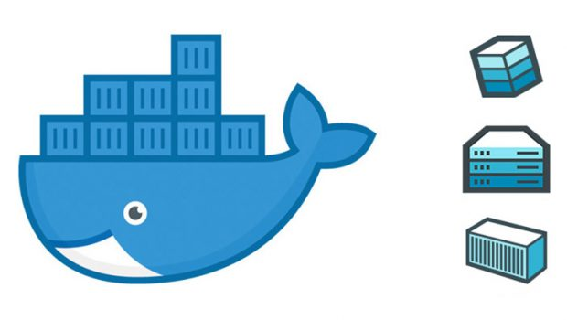
Learning Axis Hackathon – AiKiDo Team Members: 1. Himanshu Gupta (Emp # 23170) 2. Somnath Banerjee (Emp # 36921)

Slide 2
Content
1. Idea Summary
2. Idea Implementation Plan
3. Values & Benefits

Slide 3
Idea Summary
Ideation Theme:
Cloud Infrastructure – Deployment and Maintenance Solution, DevOps Automation
Background: The current PaaS solution requires writing a Dockerfile to deploy any application. This strategy is also call Bring Your Own Image (BYOI). Writing the Dockerfile can lead to many security risks as people can embed unnecessary or malicious softwares, do not follow best practices
Challenges seen in DockerFile-based build process
The monolith nature of creating dockerfile becomes difficult to maintain.
Dockerfile gets created by individual developers and a proper standard is not being followed.
Security has always been an issue with dockerfile. Viz, requires root access, malicious code injection, etc.
Not efficient as it need Docker daemon process to run in background and all steps get executed everytime a build is triggered.
Solution Summary:
Remove dependency from writing complex docker files and docker builds.
Implement a secured way to create and run OCI compliant images.
Use the latest cloud native tools (Buildah, Skopeo, Podman) to manage container needs in a secured and standard manner.
Building an OCI complaint image from anywhere without depending on priviledged access and process to run.
Technology & Resources : WSL, Podman, Buildah, S2I images ,OCP

Slide 4
Use-case summary
Ideation Theme:
Cloud Infrastructure – Deployment and Maintenance Solution, DevOps Automation
Use case 1: Creation of hardened OCI compliant images as per the corporate policy using source to image transformation process . This can be built from anywhere without dependency on access privileges , docker daemon, etc.
Use case 2: Running OCI compliant images without Docker in a secured and Standardized manner. Viz – non root user
Use case 3: Build image ones and push to different registries as per the format requirement .
Use case 4: Integrate the above 3 usecases with the complete DevOps pipeline using Buildah, Skopeo, Podman.

Slide 5
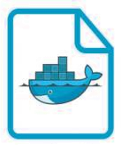







Current and Proposed approach for building container images
Developer + Operators
Developer writes application code
Developer writes DockerFile
Submits docker
build
Pushes the
image
Tags/inspect the
image
Deploy the image
Runs the
image
Manages the
image
Traditional Docker
Done by Docker
Source to Image
Developer writes application code
Build using Buildah/Kaniko
Pushes the
Image using skopeo
Tags/inspect the image using skopeo
Developers
Newer Build Tools
Deploy the image using Podman
Runs the Image using Podman
Manages the Image using Podman
No heavy dockerfile needs to be written

Slide 6





WSL2, Podman and Buildah (Next Generation of container tools)
WSL

Slide 7
Values & Benefits
S2I is used to build containerized applications by simply providing source code as an input.
Flexibility – You can customize a service to fit your needs by providing a configuration file that rewrites the values used in a container by default.
Any platform – You can use S2I for building standalone containers on several Linux platforms that provide the s2i RPM package, including Red Hat Enterprise Linux, CentOS, and Fedora or take advantage of the s2i binary.
Separated images and service configuration – Although having a clear distinction between images and service configuration allows you to perform adjustments that are more complex, the build reproducibility remains preserved at the same time.
Podman provides enhanced security. For starters, containers under the control of Podman can either be run by root or by a non-privileged user, maintaining almost all functionality. This is a great advantage since you can run your containers with different users who have different privileges.
Podman directly interacts with Image registry, containers and image storage. As we know Docker is built on top of runC runtime container and uses daemon, Instead of using daemon in Podman, it is directly using runC runtime container.
Podman is capable of using UID separation using namespaces, which provides an extra isolation layer when running containers making it a safer tool.
Buildah is a tool that facilitates building OCI container images capable of running on docker or any OCI compliant engine.
It allows for finer control of creating image layers. Committing many changes to a single layer is desirable.
Buildah can build images from scratch, that is, images with nothing in them at all.
Skopeo is a tool to inspect, push and tag images to image registry.
The $$ value benefit is while setting up the Kubernetes environment, DevOps lifecycle and container security. Estimated Cost Saving: 4-5 million USD annually

